Slide 1
Customer Churn Prediction
Contributors:
Chris Ndungu
Sylvia Muchiri
Lucky Muthoki

Slide 2
Problem Statement
Telecommunication companies provide services such as phone services, internet services, streaming service, etc. However, this telco company has been experiencing a high rate of churning of its customers.
This project aims to find the reasons why the company is losing its customers.

Slide 3
Objective
To determine the top contributors of customer churning.

Slide 4
Methodology
Data wrangling: In this section, we imported the necessary libraries, loaded the data and cleaned the data by dropping the unnecessary columns and missing values.
Exploratory data analysis: In this section, we plotted graphs to have a better understanding of the data and draw insights.
Model Selection and Evaluation: In this section, we chose two classification models , ie, Decision Tree Classifier and Random Forest Classifier. We chose accuracy and F1 as the metrics of success. After evaluation we chose the Random forest classifier which gave a better test accuracy and was performing well on the trained data.

Slide 5
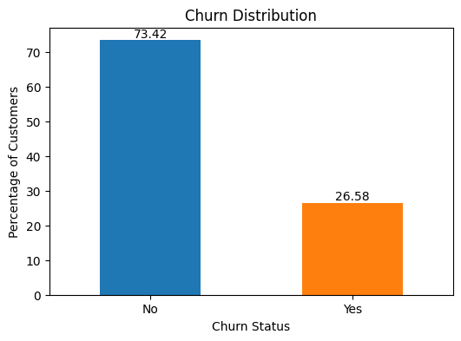
The distribution of churn shows that 73.42% of customers did not churn while 26.58% did

Slide 6
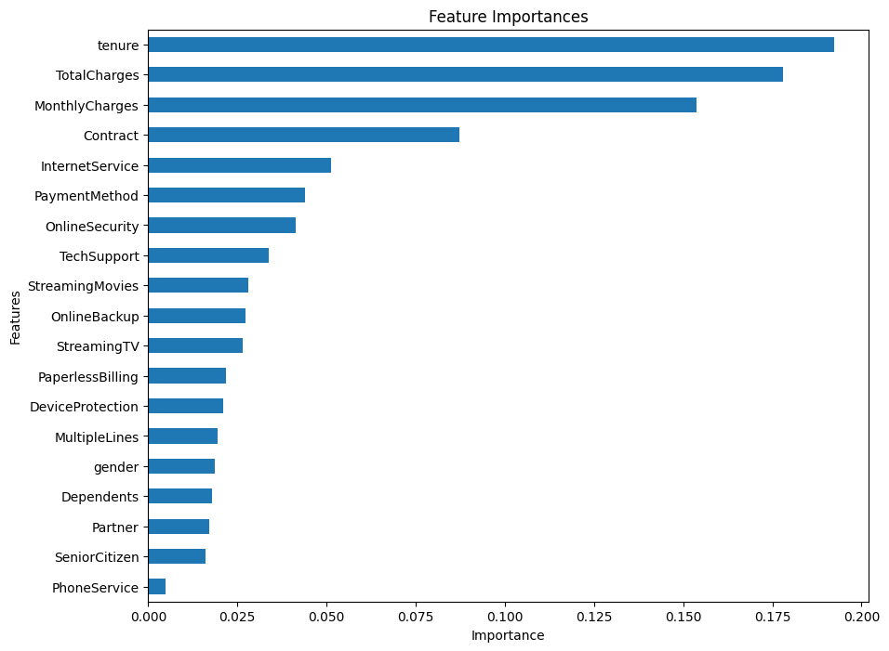
The above chart shows the contributors of customer churning. The highest contributor is tenure while the least is phone service.

Slide 7
Conclusions
Customer-Centric Approach: Adopting a customer-centric approach is paramount in addressing churn challenges and maximizing customer lifetime value. By understanding customer needs, preferences, and behavior patterns, the telecom company can deliver personalized experiences and build lasting relationships with its customers.
Improved Customer Retention: By leveraging the predictive model, the telecom company can significantly improve customer retention rates and reduce churn. Proactive retention measures, personalized offers, and targeted engagement strategies contribute to enhancing customer satisfaction and loyalty.

Slide 8
Recommendations
Service Quality Improvement: Identify and address areas of service dissatisfaction or dissatisfaction through customer feedback analysis. Improve service quality, network coverage, and customer support to enhance overall customer experience and reduce churn.
Loyalty Programs and Rewards: Introduce loyalty programs, rewards, and incentives to incentivize long-term customer relationships. Offer exclusive benefits, discounts, or rewards to loyal customers to increase retention and encourage brand loyalty.

Slide 9
Thank you!

